Slide 1
EE/CE 252/251
Signals and Systems
with
Dr. Naveed R. Butt
@
Habib University

Slide 2
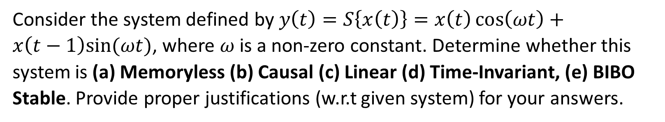
Problem
Consider the system defined by $y\left(t\right)=S\left\{x\left(t\right)\right\}=x\left(t\right)\cos\left(ωt\right)+x\left(t−1\right)sin⁡(ωt)$, where $ω$ is a non-zero constant. Determine whether this system is (a) Memoryless (b) Causal (c) Linear (d) Time-Invariant, (e) BIBO Stable. Provide proper justifications (w.r.t given system) for your answers.

Slide 3
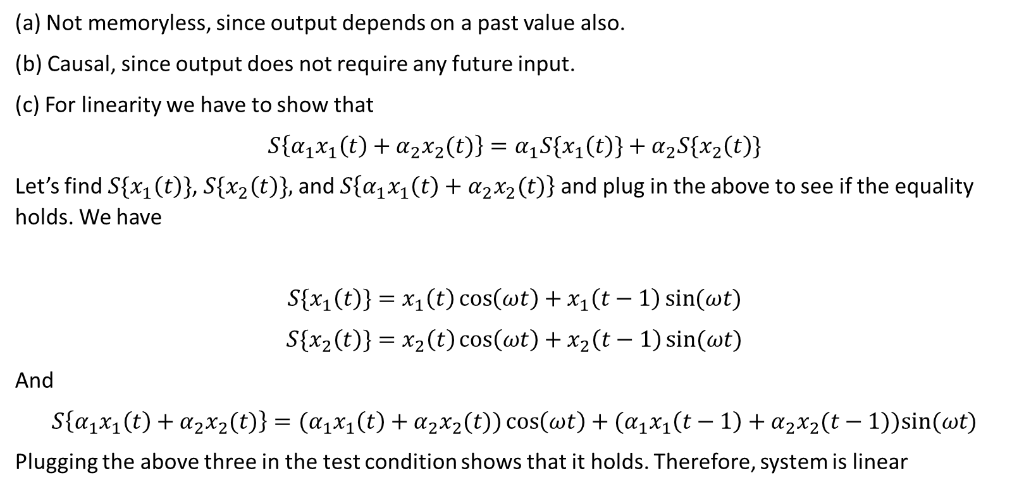
Solution
(a) Not memoryless, since output depends on a past value also.
(b) Causal, since output does not require any future input.
(c) For linearity we have to show that
$$S\left\{α_{1}x_{1}\left(t\right)+α_{2}x_{2}(t)\right\}=α_{1}{S\{x}_{1}\left(t\right)\}+α_{2}S\{x_{2}\left(t\right)\}$$
Let’s find ${S\{x}_{1}\left(t\right)\}$, ${S\{x}_{2}\left(t\right)\},$ and $S\left\{α_{1}x_{1}\left(t\right)+α_{2}x_{2}(t)\right\}$ and plug in the above to see if the equality holds. We have
$${S\{x}_{1}\left(t\right)\}=x_{1}\left(t\right)\cos\left(ωt\right)+x_{1}\left(t−1\right)\sin{(ωt)}$$
$${S\{x}_{2}\left(t\right)\}=x_{2}\left(t\right)\cos\left(ωt\right)+x_{2}\left(t−1\right)\sin{(ωt)}$$
And
$$S\left\{α_{1}x_{1}\left(t\right)+α_{2}x_{2}(t)\right\}={(α}_{1}x_{1}\left(t\right)+α_{2}x_{2}(t))\cos\left(ωt\right)+{(α}_{1}x_{1}\left(t−1\right)+α_{2}x_{2}(t−1))sin⁡(ωt)$$
Plugging the above three in the test condition shows that it holds. Therefore, system is linear

Slide 4
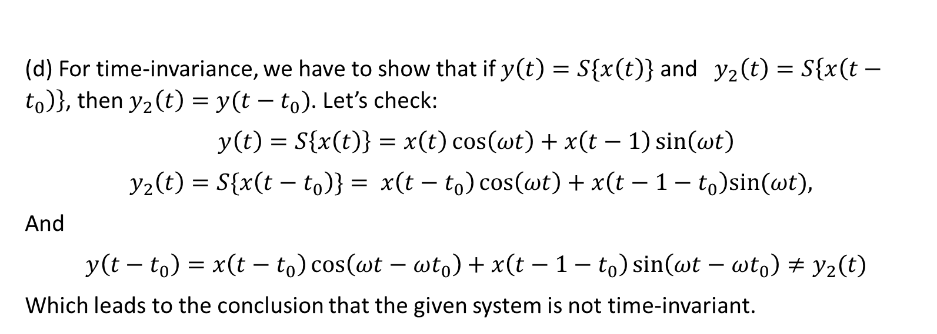
Solution
(d) For time-invariance, we have to show that if $y\left(t\right)=S\{x\left(t\right)\}$ and $y_{2}\left(t\right)=S\left\{x\left(t−t_{0}\right)\right\}$, then $y_{2}\left(t\right)=y(t−t_{0})$. Let’s check:
$$y\left(t\right)=S\left\{x\left(t\right)\right\}=x\left(t\right)\cos\left(ωt\right)+x\left(t−1\right)\sin\left(ωt\right)$$
$$y_{2}\left(t\right)=S\{x\left(t−t_{0}\right)\}= x\left(t−t_{0}\right)\cos\left(ωt\right)+x\left(t−1−t_{0}\right)sin⁡(ωt),$$
And
$$y\left(t−t_{0}\right)=x\left(t−t_{0}\right)\cos\left(ωt−ωt_{0}\right)+x\left(t−1−t_{0}\right)\sin\left(ωt−ωt_{0}\right)≠y_{2}(t)$$
Which leads to the conclusion that the given system is not time-invariant.

Slide 5
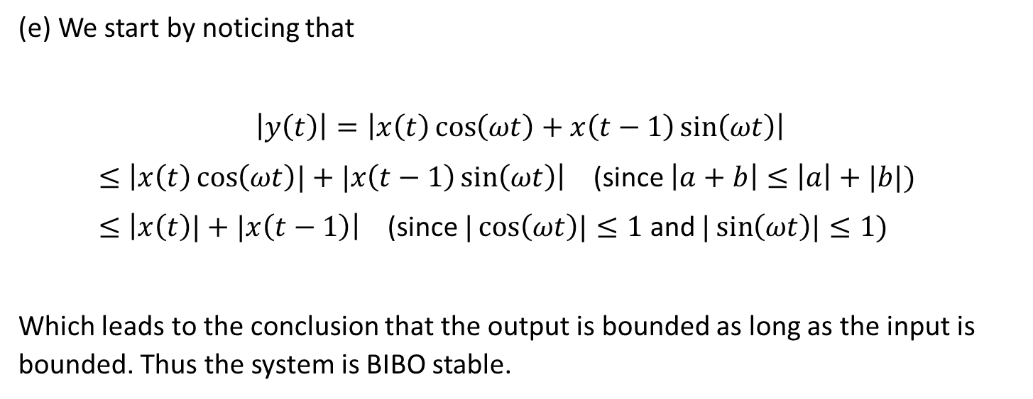
Solution
(e) We start by noticing that
$$\left|y\left(t\right)\right|=\left|x\left(t\right)\cos\left(ωt\right)+x\left(t−1\right)\sin\left(ωt\right)\right|$$
$≤\left|x\left(t\right)\cos\left(ωt\right)|+|x\left(t−1\right)\sin\left(ωt\right)\right|$ (since $\left|a+b\right|≤\left|a\right|+|b|)$
$≤\left|x\left(t\right)|+|x\left(t−1\right)\right|$ (since $|\cos\left(ωt\right)|≤1$ and $|\sin\left(ωt\right)|≤1)$
Which leads to the conclusion that the output is bounded as long as the input is bounded. Thus the system is BIBO stable.

Slide 6
Problem

Slide 7
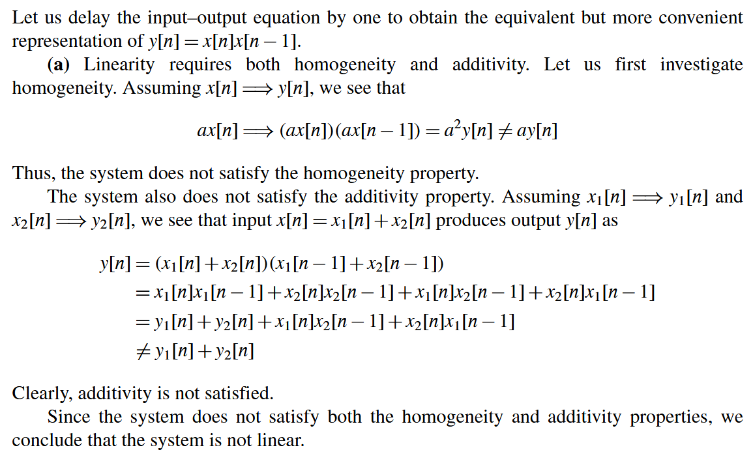
Solution
Homogeneity and additivity both tested here for practice. Otherwise, we know that even if one of the two fails, the system is nonlinear.

Slide 8
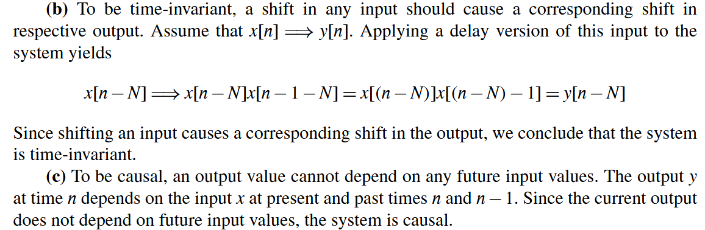

Slide 9
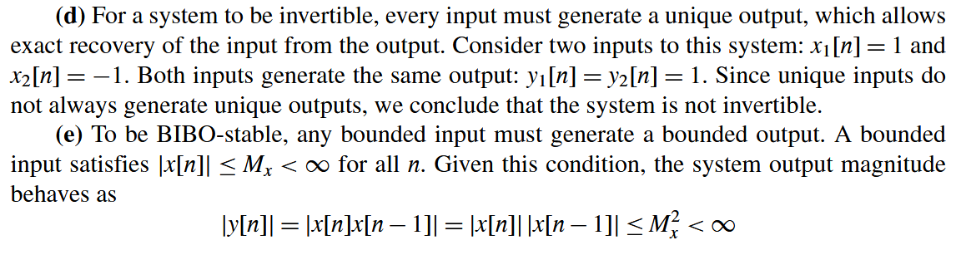
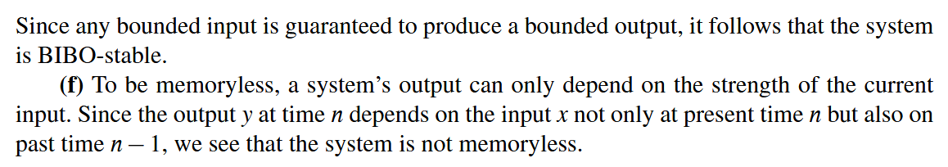

Slide 10
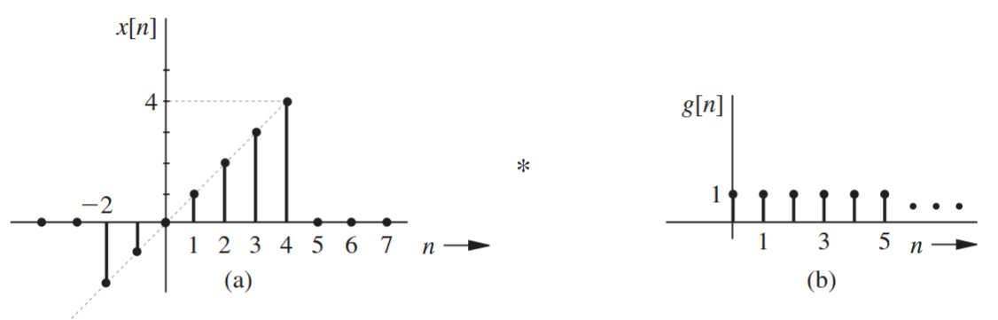
Problem
Use sliding-tape method to find $c\left[n\right]=x\left[n\right]∗g[n]$

Slide 11
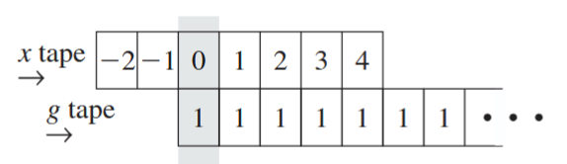
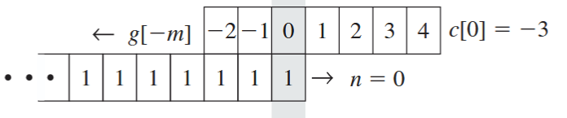
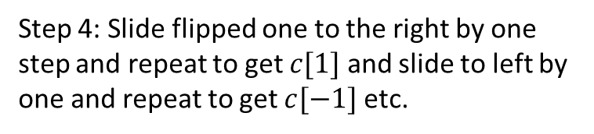
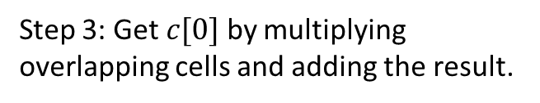
Solution
Step 1: Write the two sequences on tapes such that their zeros align (insert zeros in a given function if required)
Step 2: Flip any one of them (since convolution is commutative) about the aligned axis.
Step 3: Get $c[0]$ by multiplying overlapping cells and adding the result.
Step 4: Slide flipped one to the right by one step and repeat to get $c[1]$ and slide to left by one and repeat to get $c[−1]$ etc.

Slide 12
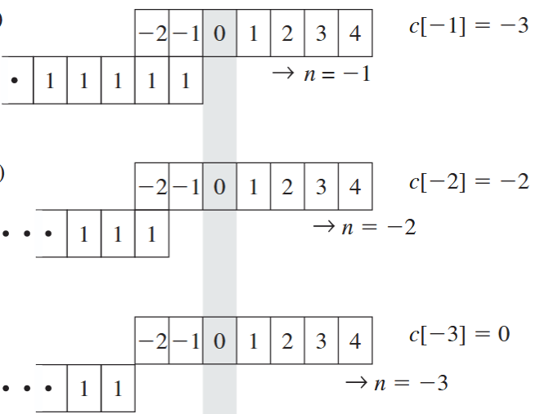
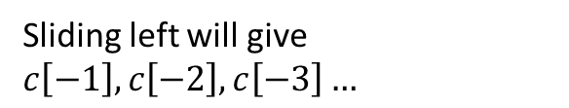
Sliding left will give $c\left[−1\right], c\left[−2\right], c\left[−3\right]…$

Slide 13
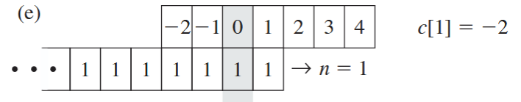
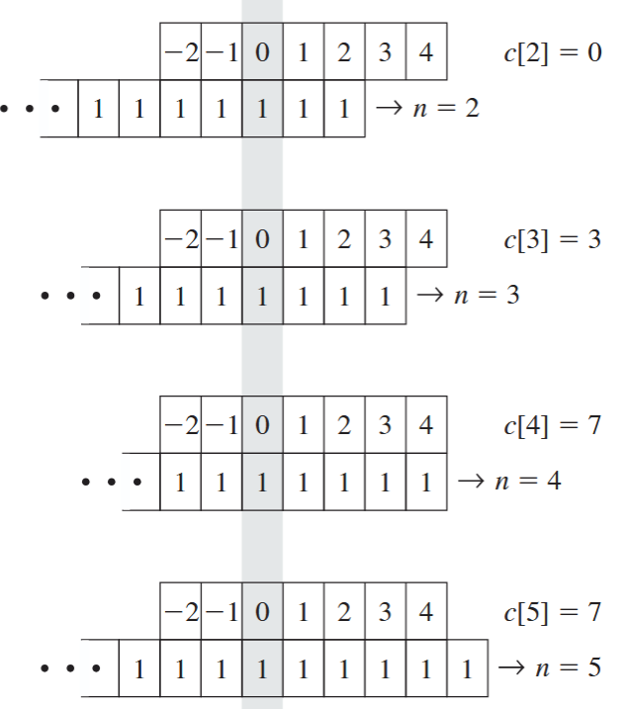
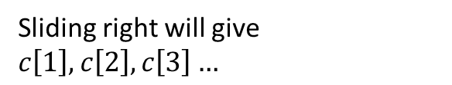
Sliding right will give $c\left[1\right], c\left[2\right], c\left[3\right]…$

Slide 14
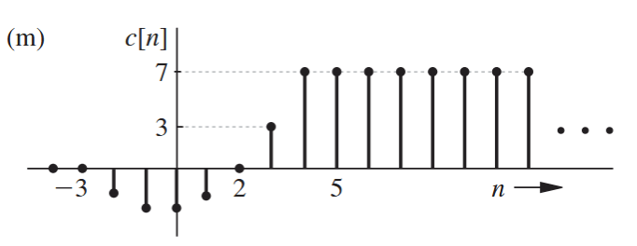
Step 5: Once we have all the non-zero values, we can plot the result…

Slide 15
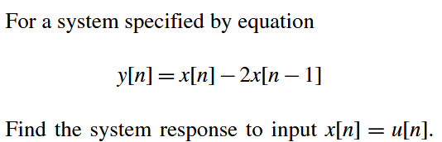
Problem

Slide 16
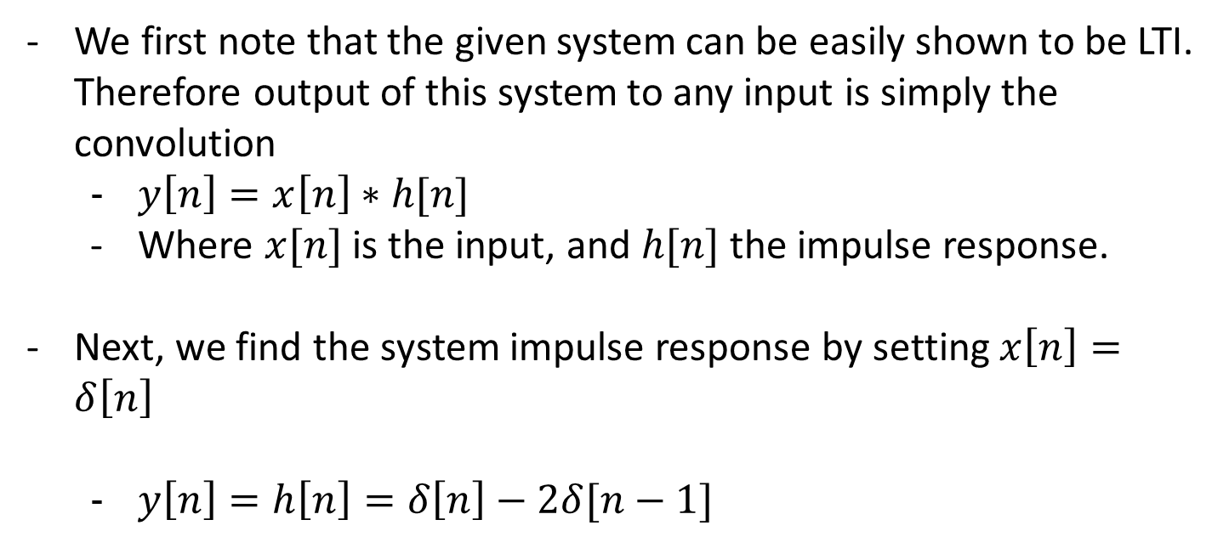
Solution
We first note that the given system can be easily shown to be LTI. Therefore output of this system to any input is simply the convolution
  $y\left[n\right]=x\left[n\right]∗h[n]$
  Where $x[n]$ is the input, and $h[n]$ the impulse response.
Next, we find the system impulse response by setting $x\left[n\right]=δ\left[n\right]$
  $y\left[n\right]=h\left[n\right]=δ\left[n\right]−2δ[n−1]$

Slide 17
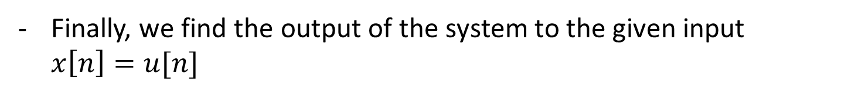


Solution
Finally, we find the output of the system to the given input $x\left[n\right]=u[n]$
$$y\left[n\right]=x\left[n\right]∗h\left[n\right]=u\left[n\right]∗\left(δ\left[n\right]−2δ\left[n−1\right]\right)=u\left[n\right]∗δ\left[n\right]−2(u\left[n\right]∗δ\left[n−1\right])$$
$$=u\left[n\right]−2u[n−1]$$
Note: in the above we have used
Distributive property of convolution
Fact that $δ(t)$ is the identity of convolution
Shifting property of convolution

Slide 18
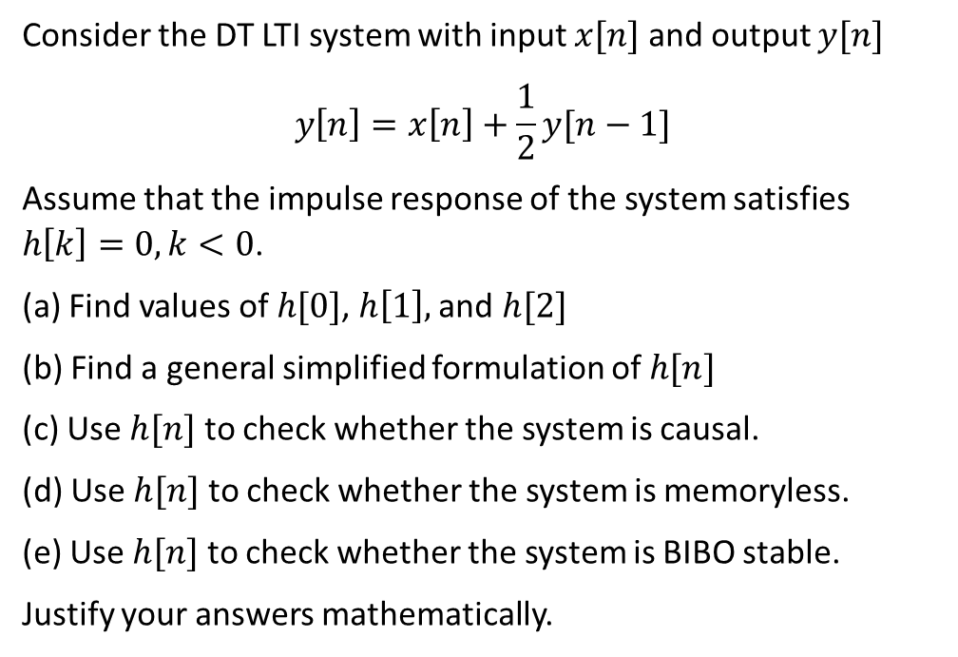
Problem
Consider the DT LTI system with input $x[n]$ and output $y[n]$
$$y\left[n\right]=x\left[n\right]+\frac{1}{2}y[n−1]$$
Assume that the impulse response of the system satisfies $h\left[k\right]=0, k<0$.
(a) Find values of $h[0]$, $h\left[1\right],$ and $h[2]$
(b) Find a general simplified formulation of $h[n]$
(c) Use $h[n]$ to check whether the system is causal.
(d) Use $h[n]$ to check whether the system is memoryless.
(e) Use $h[n]$ to check whether the system is BIBO stable.
Justify your answers mathematically.

Slide 19
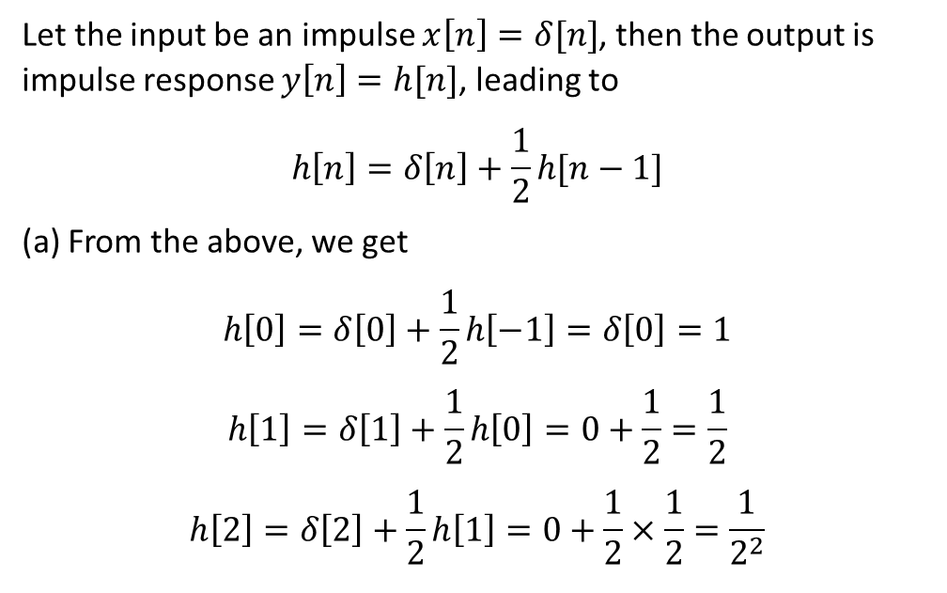
Solution
Let the input be an impulse $x\left[n\right]=δ[n]$, then the output is impulse response $y\left[n\right]=h[n]$, leading to
$$h\left[n\right]=δ\left[n\right]+\frac{1}{2}h[n−1]$$
(a) From the above, we get
$$h\left[0\right]=δ\left[0\right]+\frac{1}{2}h\left[−1\right]=δ\left[0\right]=1$$
$$h\left[1\right]=δ\left[1\right]+\frac{1}{2}h\left[0\right]=0+\frac{1}{2}=\frac{1}{2}$$
$$h\left[2\right]=δ\left[2\right]+\frac{1}{2}h\left[1\right]=0+\frac{1}{2}×\frac{1}{2}=\frac{1}{2^{2}}$$

Slide 20
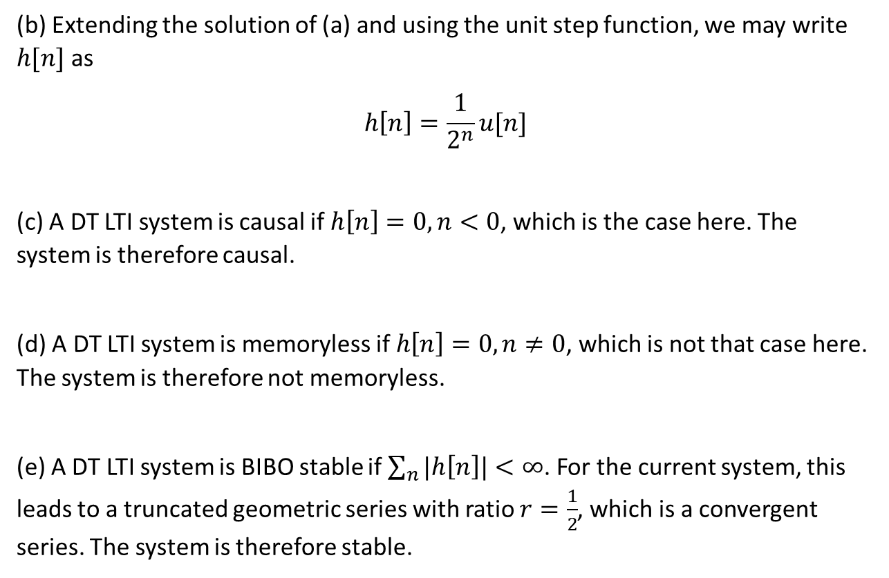
(b) Extending the solution of (a) and using the unit step function, we may write $h[n]$ as
$$h\left[n\right]=\frac{1}{2^{n}}u[n]$$
(c) A DT LTI system is causal if $h\left[n\right]=0, n<0$, which is the case here. The system is therefore causal.
(d) A DT LTI system is memoryless if $h\left[n\right]=0, n≠0$, which is not that case here. The system is therefore not memoryless.
(e) A DT LTI system is BIBO stable if $\sum_{n}{|h\left[n\right]|}<∞$. For the current system, this leads to a truncated geometric series with ratio $r=\frac{1}{2}$, which is a convergent series. The system is therefore stable.

Slide 21
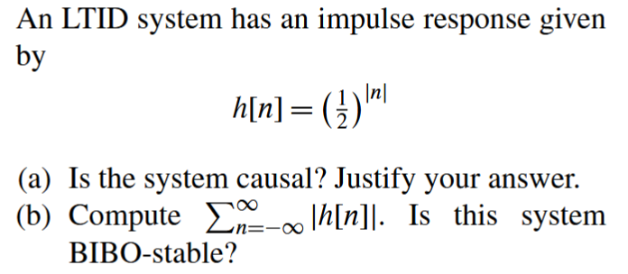
Problem

Slide 22
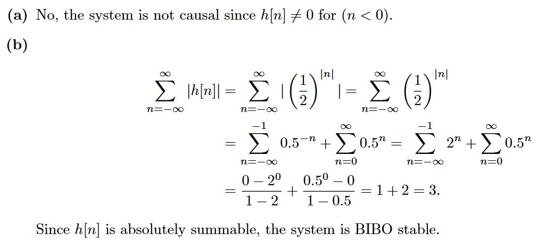
Solution

Slide 23


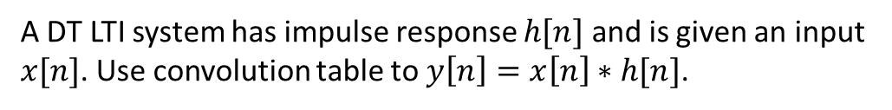
Problem
A DT LTI system has impulse response $h[n]$ and is given an input $x[n]$. Use convolution table to $y\left[n\right]=x\left[n\right]∗h[n]$.

Slide 24
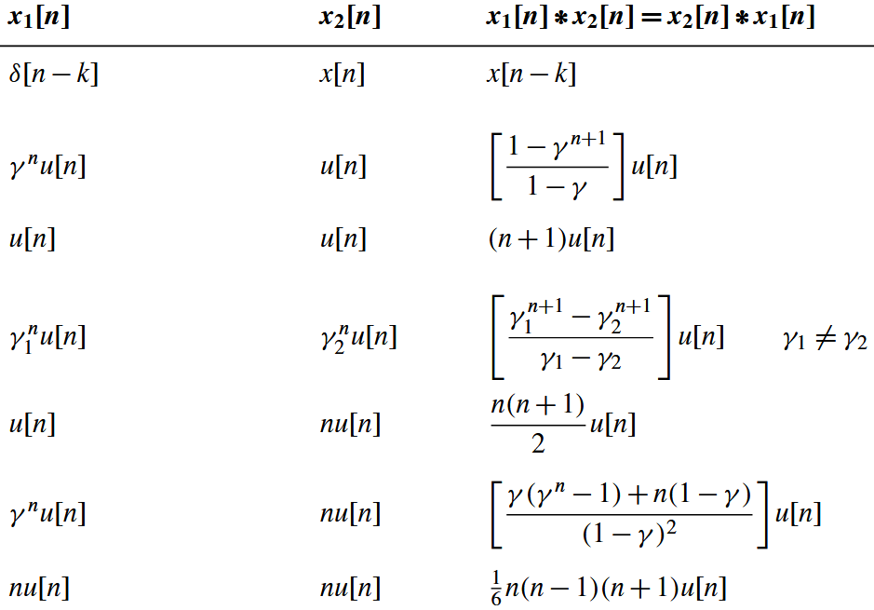

Slide 25
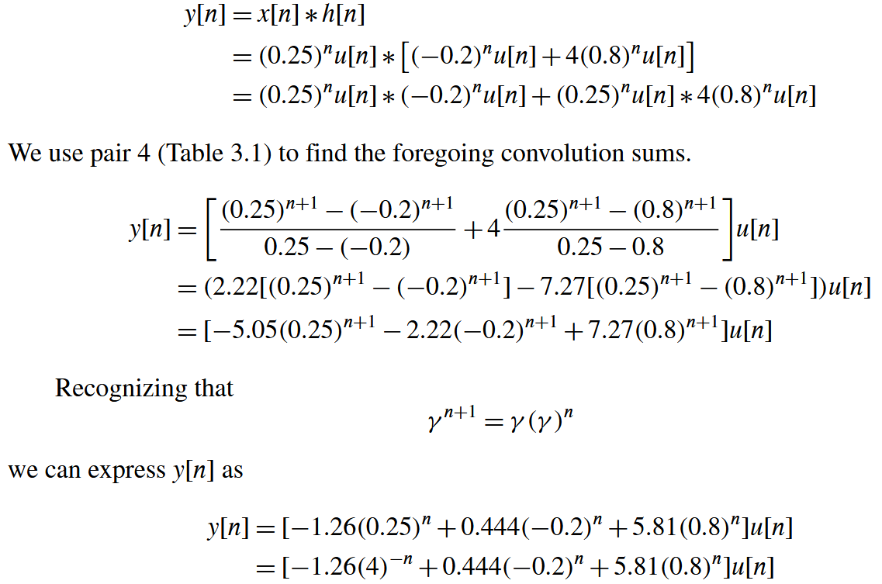
Solution

Slide 26
Problem

Slide 27
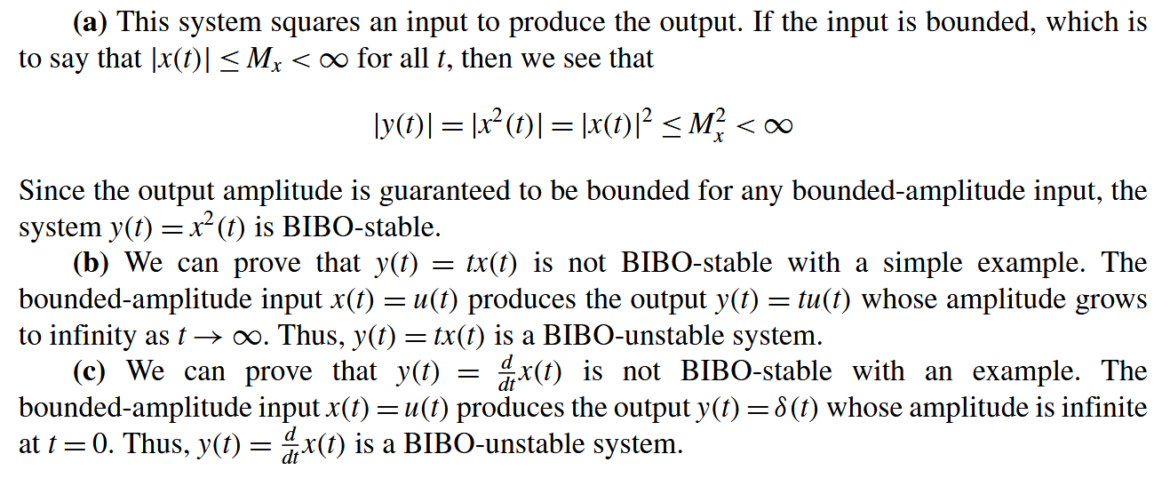
Solution

Slide 28
Problem

Slide 29
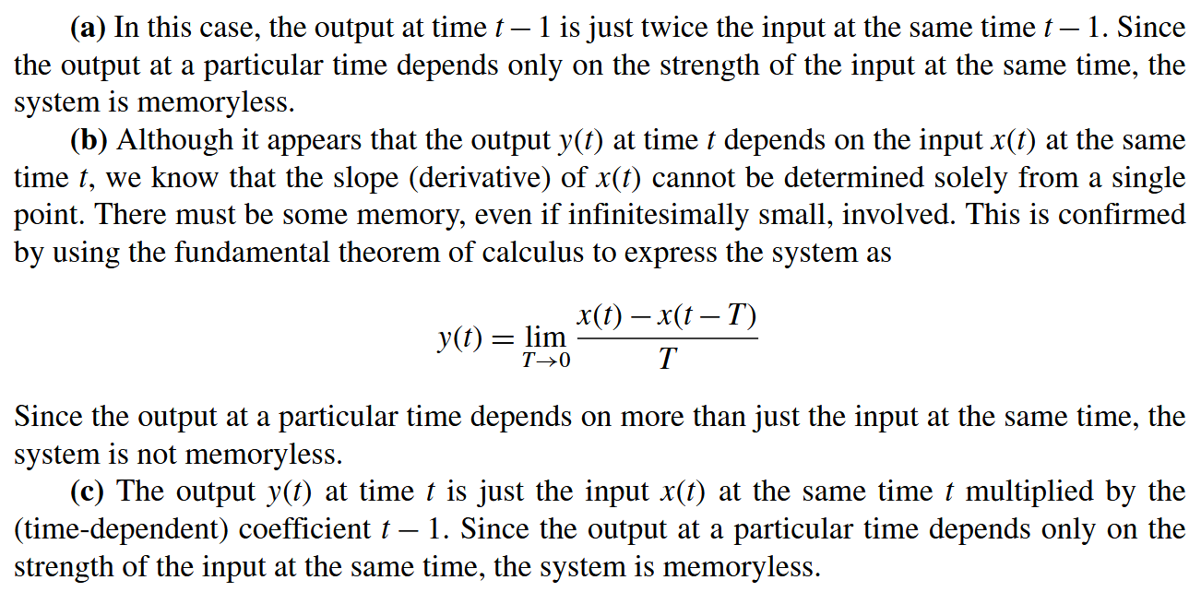
Solution

Slide 30
Problem

Slide 31
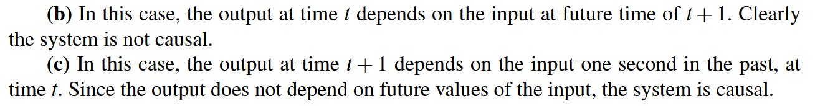
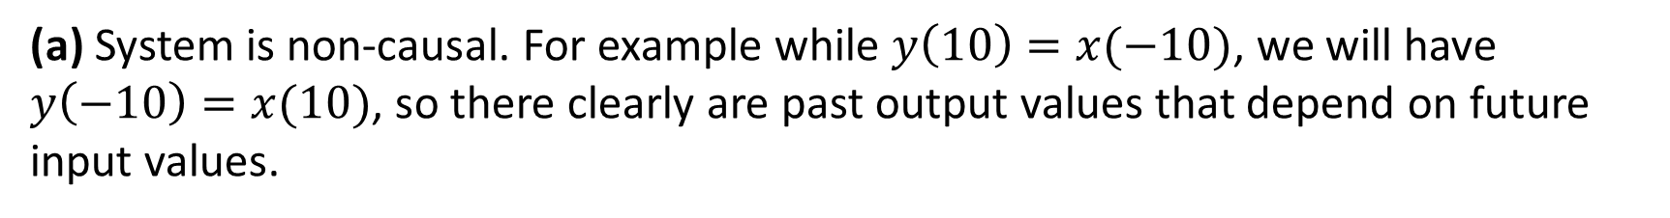
Solution
(a) System is non-causal. For example while $y\left(10\right)=x(−10)$, we will have $y\left(−10\right)=x(10)$, so there clearly are past output values that depend on future input values.

Slide 32
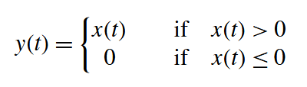
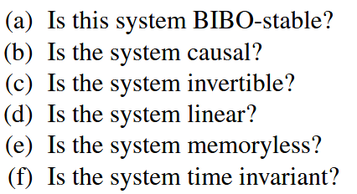
Problem
Basically, this system clips any negative-amplitude part of the signal.

Slide 33
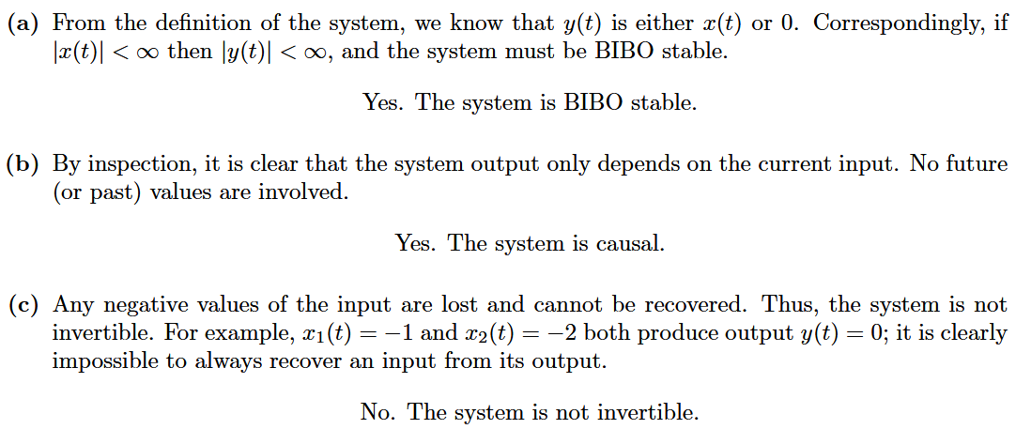
Solution

Slide 34
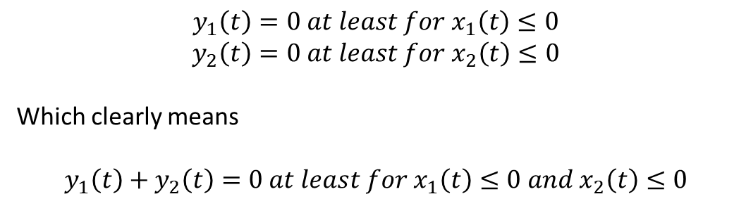

(d)
For more involved systems like these, we can also try to prove by counterexamples or by testing additivity and homogeneity separately. Let’s see two approaches.
$$y_{1}\left(t\right)=0 at least for x_{1}\left(t\right)≤0$$
$$y_{2}\left(t\right)=0 at least for x_{2}\left(t\right)≤0$$
Which clearly means
$$y_{1}\left(t\right)+y_{2}\left(t\right)=0 at least for x_{1}\left(t\right)≤0 and x_{2}\left(t\right)≤0$$
$$x_{1}\left(t\right)≤−x_{2}(t)$$
But $y_{3}\left(t\right)=S\left\{x_{1}\left(t\right)+x_{2}\left(t\right)\right\}=0 at least for x_{1}\left(t\right)+x_{2}\left(t\right)≤0$
Since the two lead to different conditions, we conclude that the system fails additivity and cannot be linear.

Slide 35
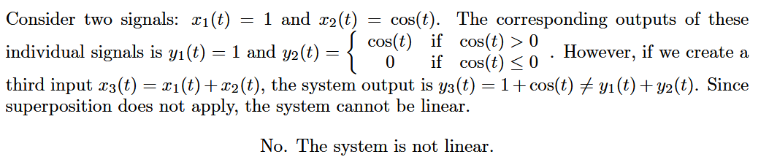

Here’s an example of proof by counterexample:
Since $1+\cos{(t)}$ is always non-negative.

Slide 36
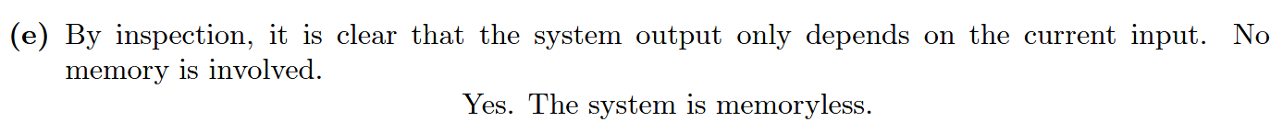
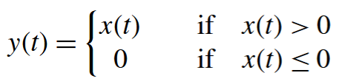


(f)
For time-invariance, we have to show that if $y(t)=S\{x\left(t\right)\}$ and $y_{2}\left(t\right)=S\left\{x\left(t−τ\right)\right\}$, then $y_{2}\left(t\right)=y(t−τ)$. Let’s check:
$$y\left(t−τ\right)=$$
Clearly $y_{2}\left(t\right)=y(t−τ)$, and we conclude that the system is time-invariant.

Slide 37
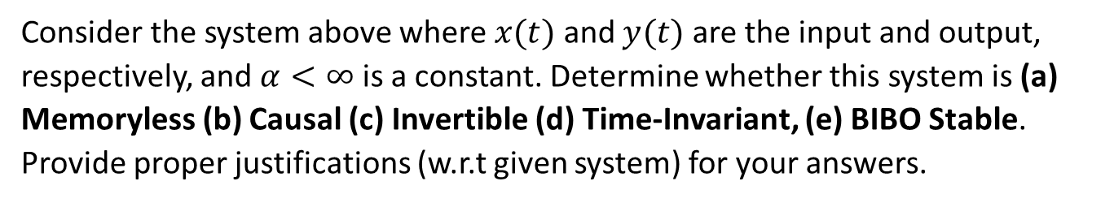
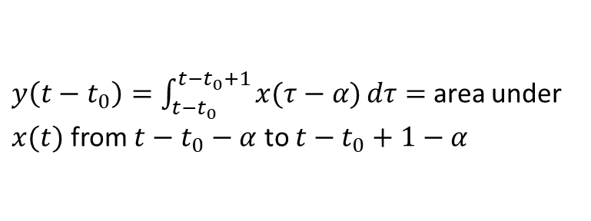
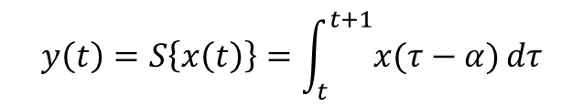
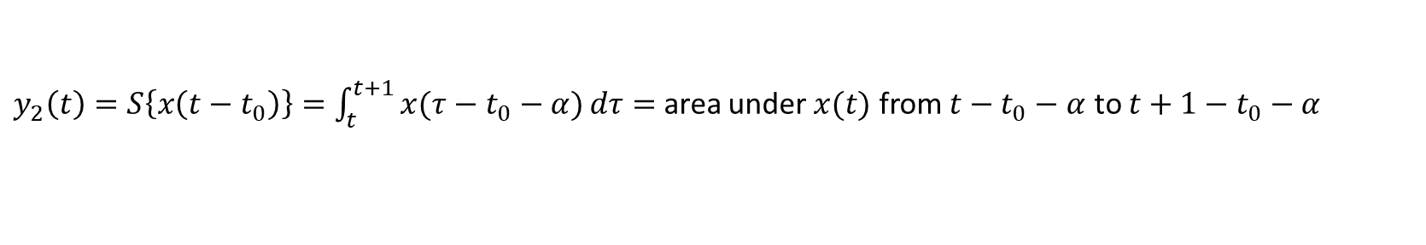
Problem
Consider the system above where $x(t)$ and $y(t)$ are the input and output, respectively, and $α<∞$ is a constant. Determine whether this system is (a) Memoryless (b) Causal (c) Invertible (d) Time-Invariant, (e) BIBO Stable. Provide proper justifications (w.r.t given system) for your answers.
$y\left(t−t_{0}\right)=\int_{t−t_{0}}^{t−t_{0}+1}{x(τ−α)}dτ=$ area under $x(t)$ from $t−t_{0}−α$ to $t−t_{0}+1−α$
$$y\left(t\right)=S\left\{x\left(t\right)\right\}=\int_{t}^{t+1}{x(τ−α)}dτ$$
$y_{2}\left(t\right)=S\left\{x\left(t−t_{0}\right)\right\}=\int_{t}^{t+1}{x(τ−t_{0}−α)}dτ=$ area under $x(t)$ from $t−t_{0}−α$ to $t+1−t_{0}−α$
Clearly, $y_{2}\left(t\right)=y(t−t_{0})$

Slide 38
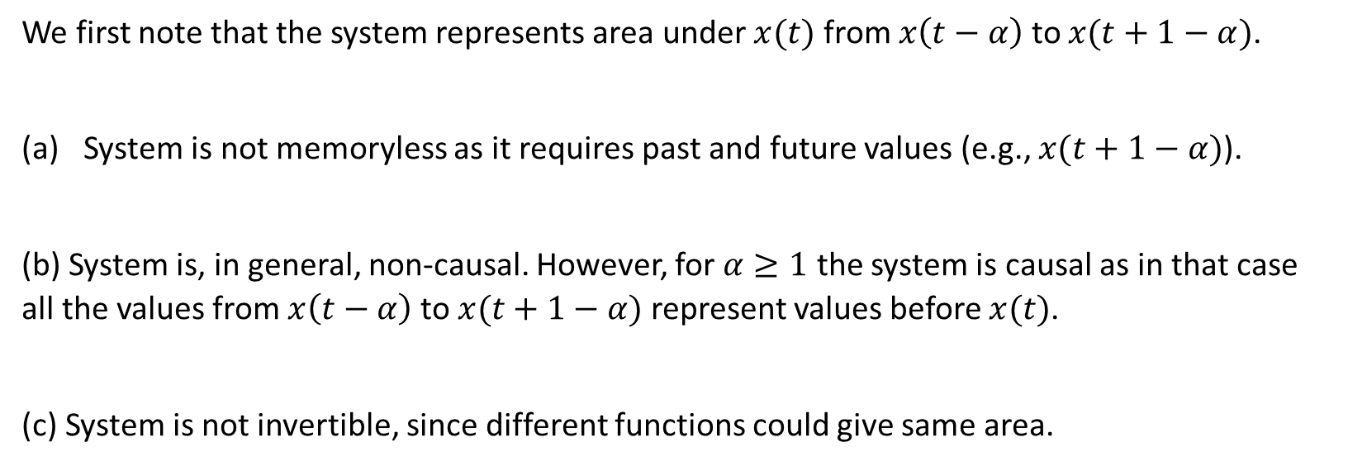
Solution
We first note that the system represents area under $x(t)$ from $x\left(t−α\right)$ to $x(t+1−α)$.
System is not memoryless as it requires past and future values (e.g., $x(t+1−α)$).
(b) System is, in general, non-causal. However, for $α≥1$ the system is causal as in that case all the values from $x\left(t−α\right)$ to $x(t+1−α)$ represent values before $x(t)$.
(c) System is not invertible, since different functions could give same area.

Slide 39
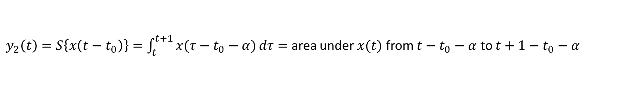
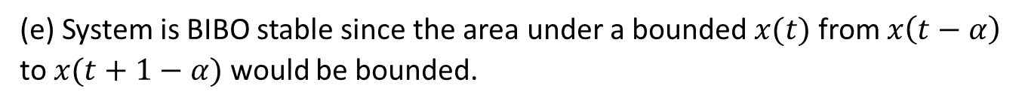
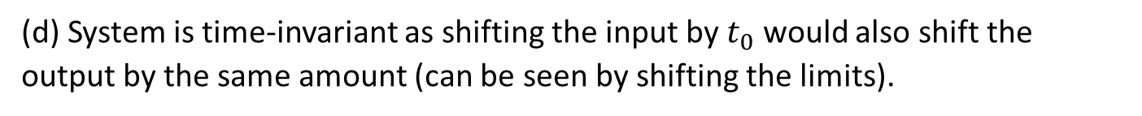
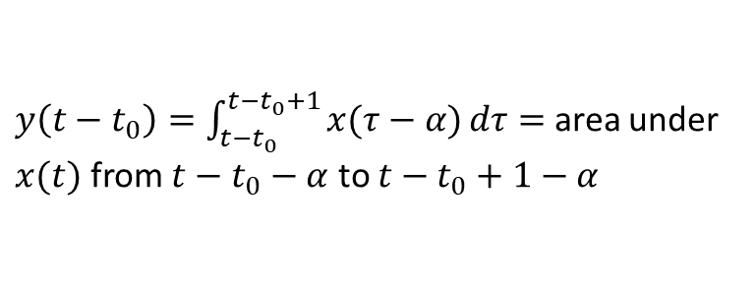

(d) System is time-invariant as shifting the input by $t_{0}$ would also shift the output by the same amount (can be seen by shifting the limits).
$$y\left(t\right)=S\left\{x\left(t\right)\right\}=\int_{t}^{t+1}{x(τ−α)}dτ$$
$y\left(t−t_{0}\right)=\int_{t−t_{0}}^{t−t_{0}+1}{x(τ−α)}dτ=$ area under $x(t)$ from $t−t_{0}−α$ to $t−t_{0}+1−α$
$y_{2}\left(t\right)=S\left\{x\left(t−t_{0}\right)\right\}=\int_{t}^{t+1}{x(τ−t_{0}−α)}dτ=$ area under $x(t)$ from $t−t_{0}−α$ to $t+1−t_{0}−α$
Clearly, $y_{2}\left(t\right)=y(t−t_{0})$
(e) System is BIBO stable since the area under a bounded $x(t)$ from $x\left(t−α\right)$ to $x(t+1−α)$ would be bounded.

Slide 40


Questions?? Thoughts??

